Slide 1
Reactive programming
by Romans

Slide 2
What is it?
Programming paradigm where data (I/O) is treated as a bunch of streams
Centered around Observable/Observer/Scheduler

Slide 3
Why?
Why not?
Hype-driven development
Threading
Error handling
Observe events as you go

Slide 4
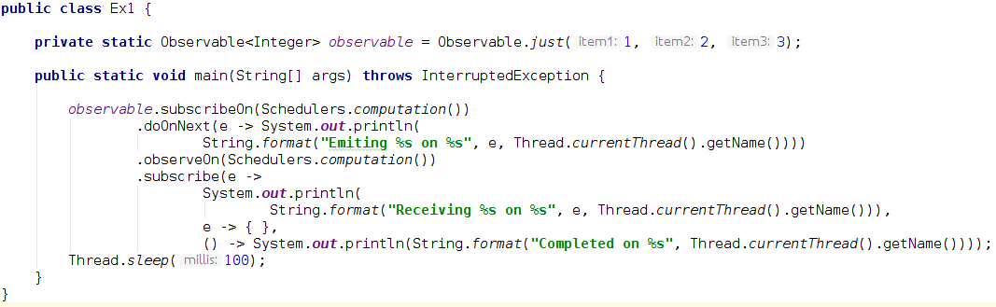
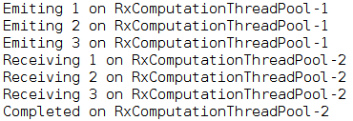
Simple example

Slide 5
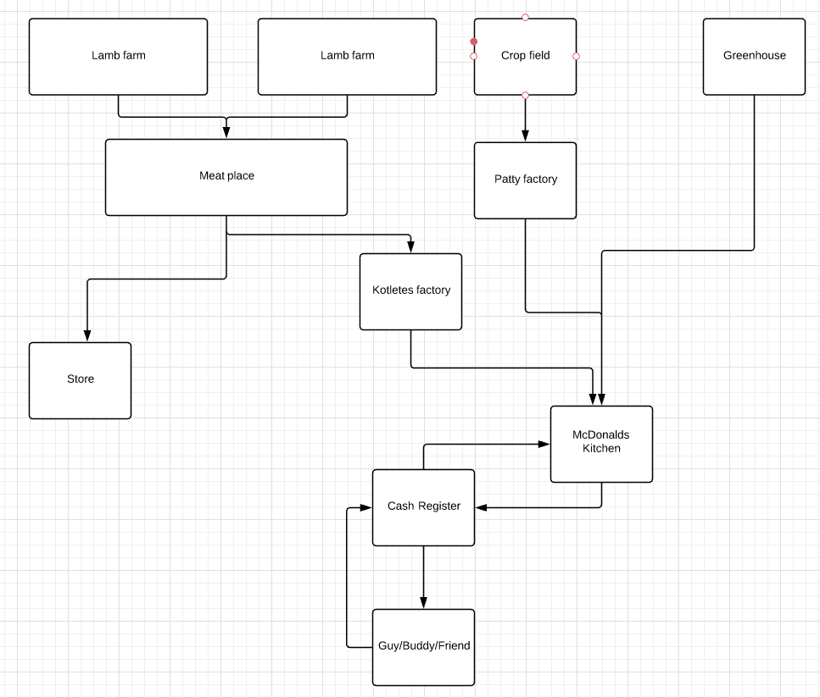
Simple Reactive app

Slide 6
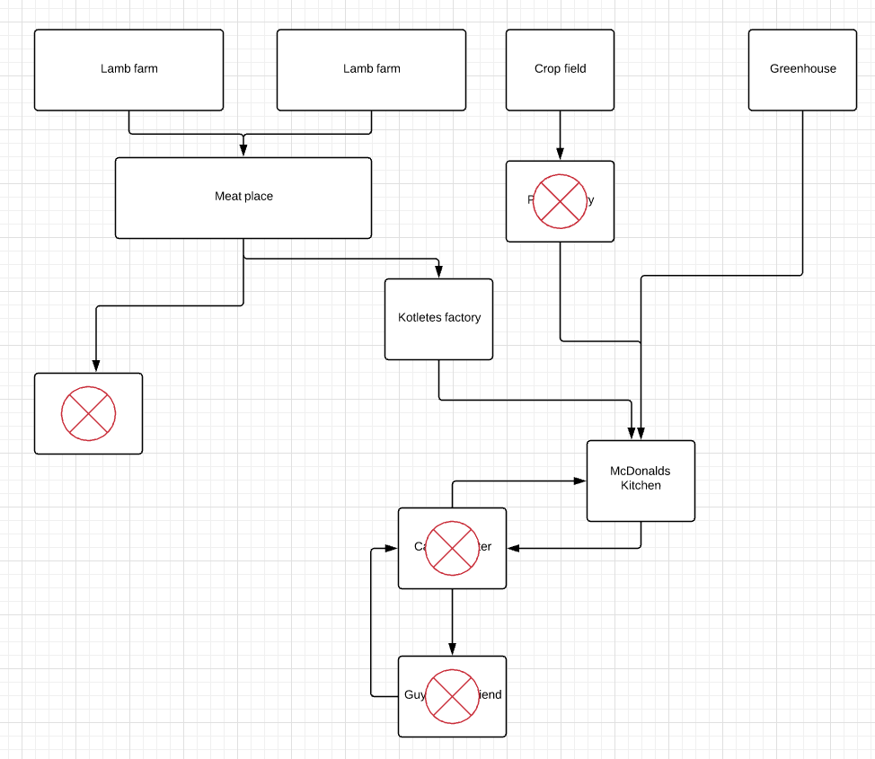
Simple Reactive app

Slide 7
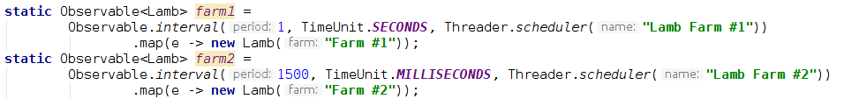
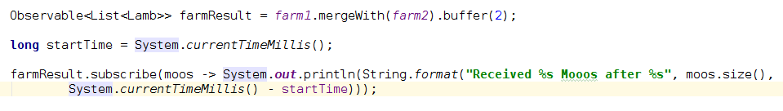
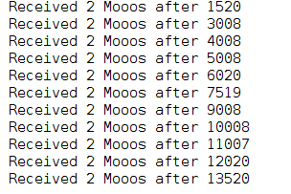
Lamb Farms

Slide 8

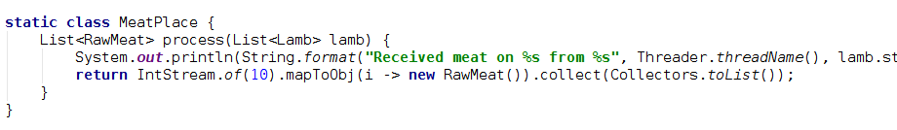
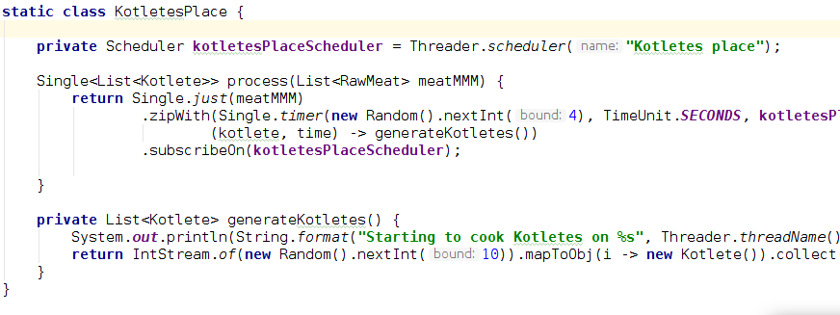
Lamb to kotlete

Slide 9
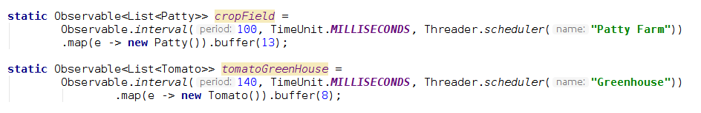
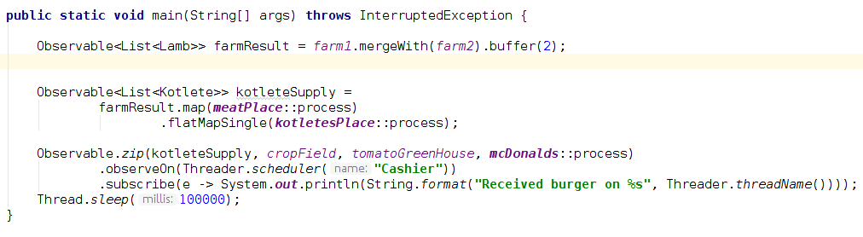
Other burger supplies

Slide 10
Operators
flatMap
concatMap
zip
just
timer
combineLatest
debounce
retry
Map
create

Slide 11
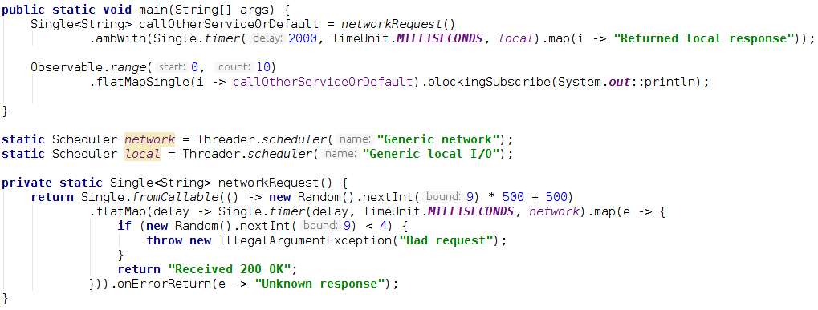
Fail-safe network service

Slide 12
Thanks
https://github.com/romansbobans/CitadeleReactive

